Slide 1



Optimization of Lunar Map Distortion
Jessica Maldonado Olivas
Mentor: Mark McClernan
Notes:
- casual introduction: looked into how map projections were made and represented ground (lunar surface more accurately)
- optimization and refinement has never been applied before …
- mention Artemis landing sites

Slide 2
Outline & Objectives
Intro on Map Projections
Map Projection Distortion
Methods
Results
Conclusion
Investigate the feasibility of map projection optimization through the examination of three map projections with both manual refinement techniques and optimization algorithms
Notes:
- investigated the optimization of three projection methods

Slide 3
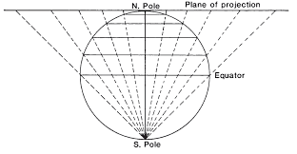
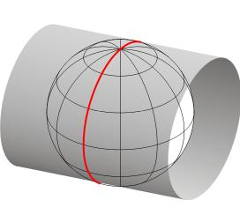
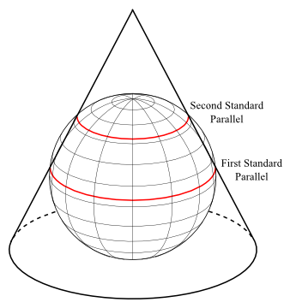
Map Projections
a method for representing part of the surface of a celestial object on a plane surface
Stereographic: planar projection
Transverse Mercator: Cylindrical projection
Lambert Conic Conformal: conic projection
Notes:
-
- introduce map projections represent a flat paper map on a surface (a map is projected onto the surface shape)
projection point
- central meridian
- standard parallel

Slide 4
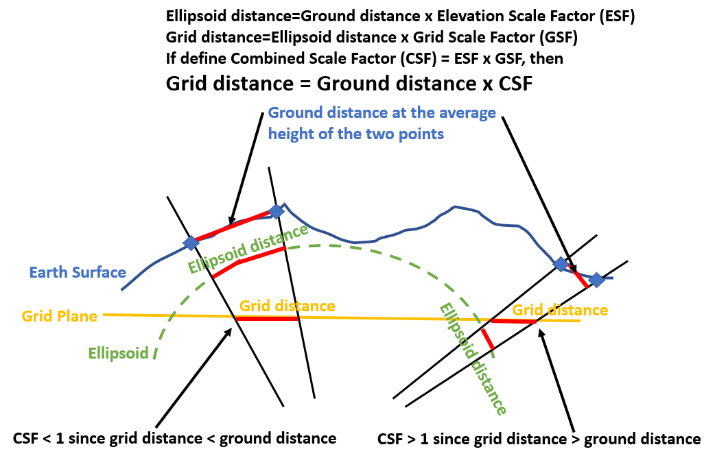
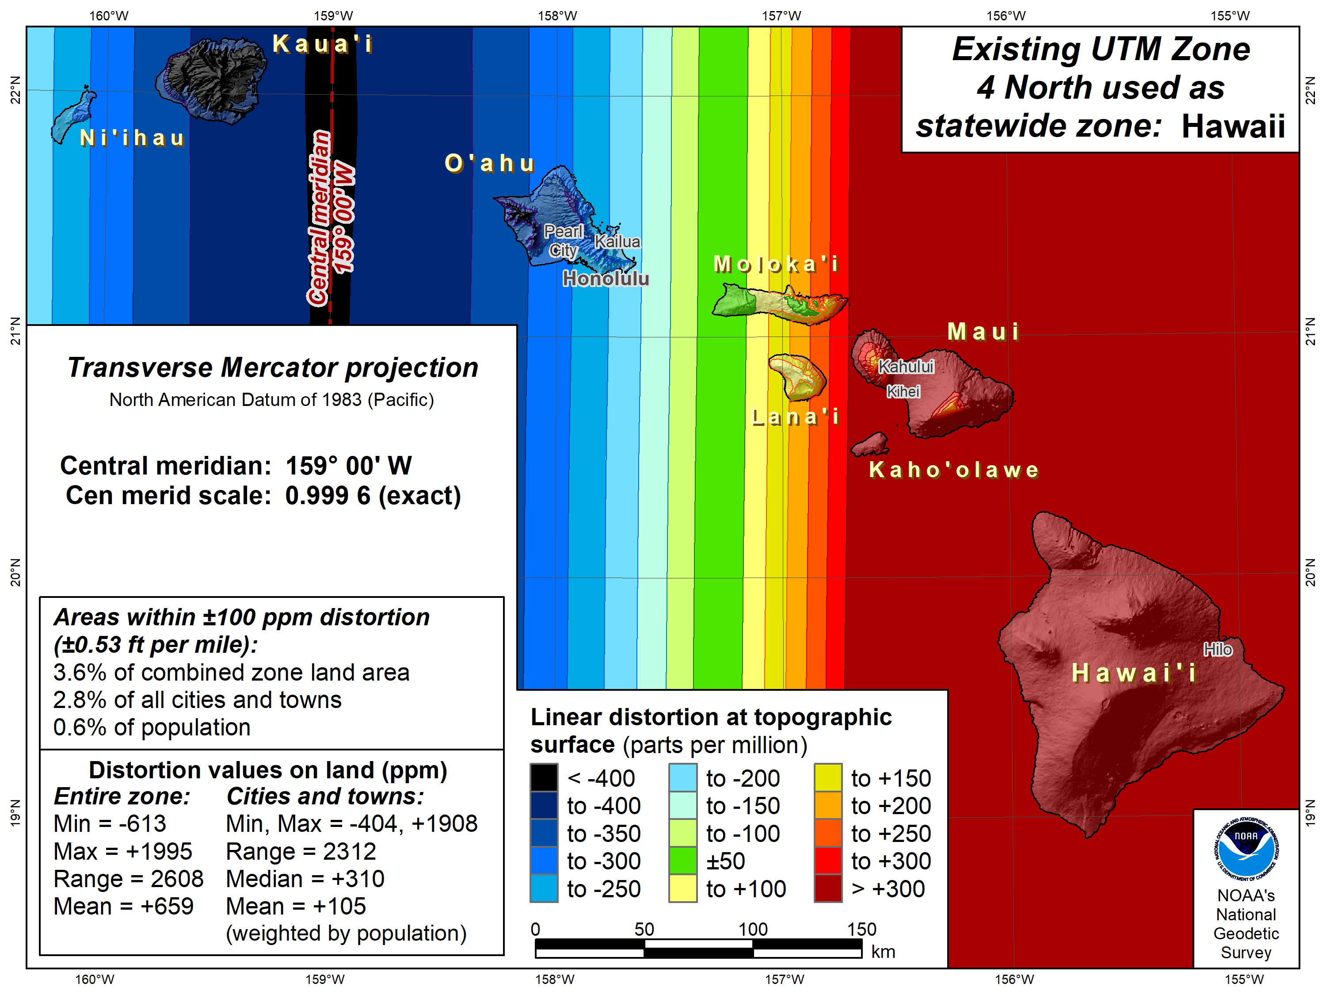
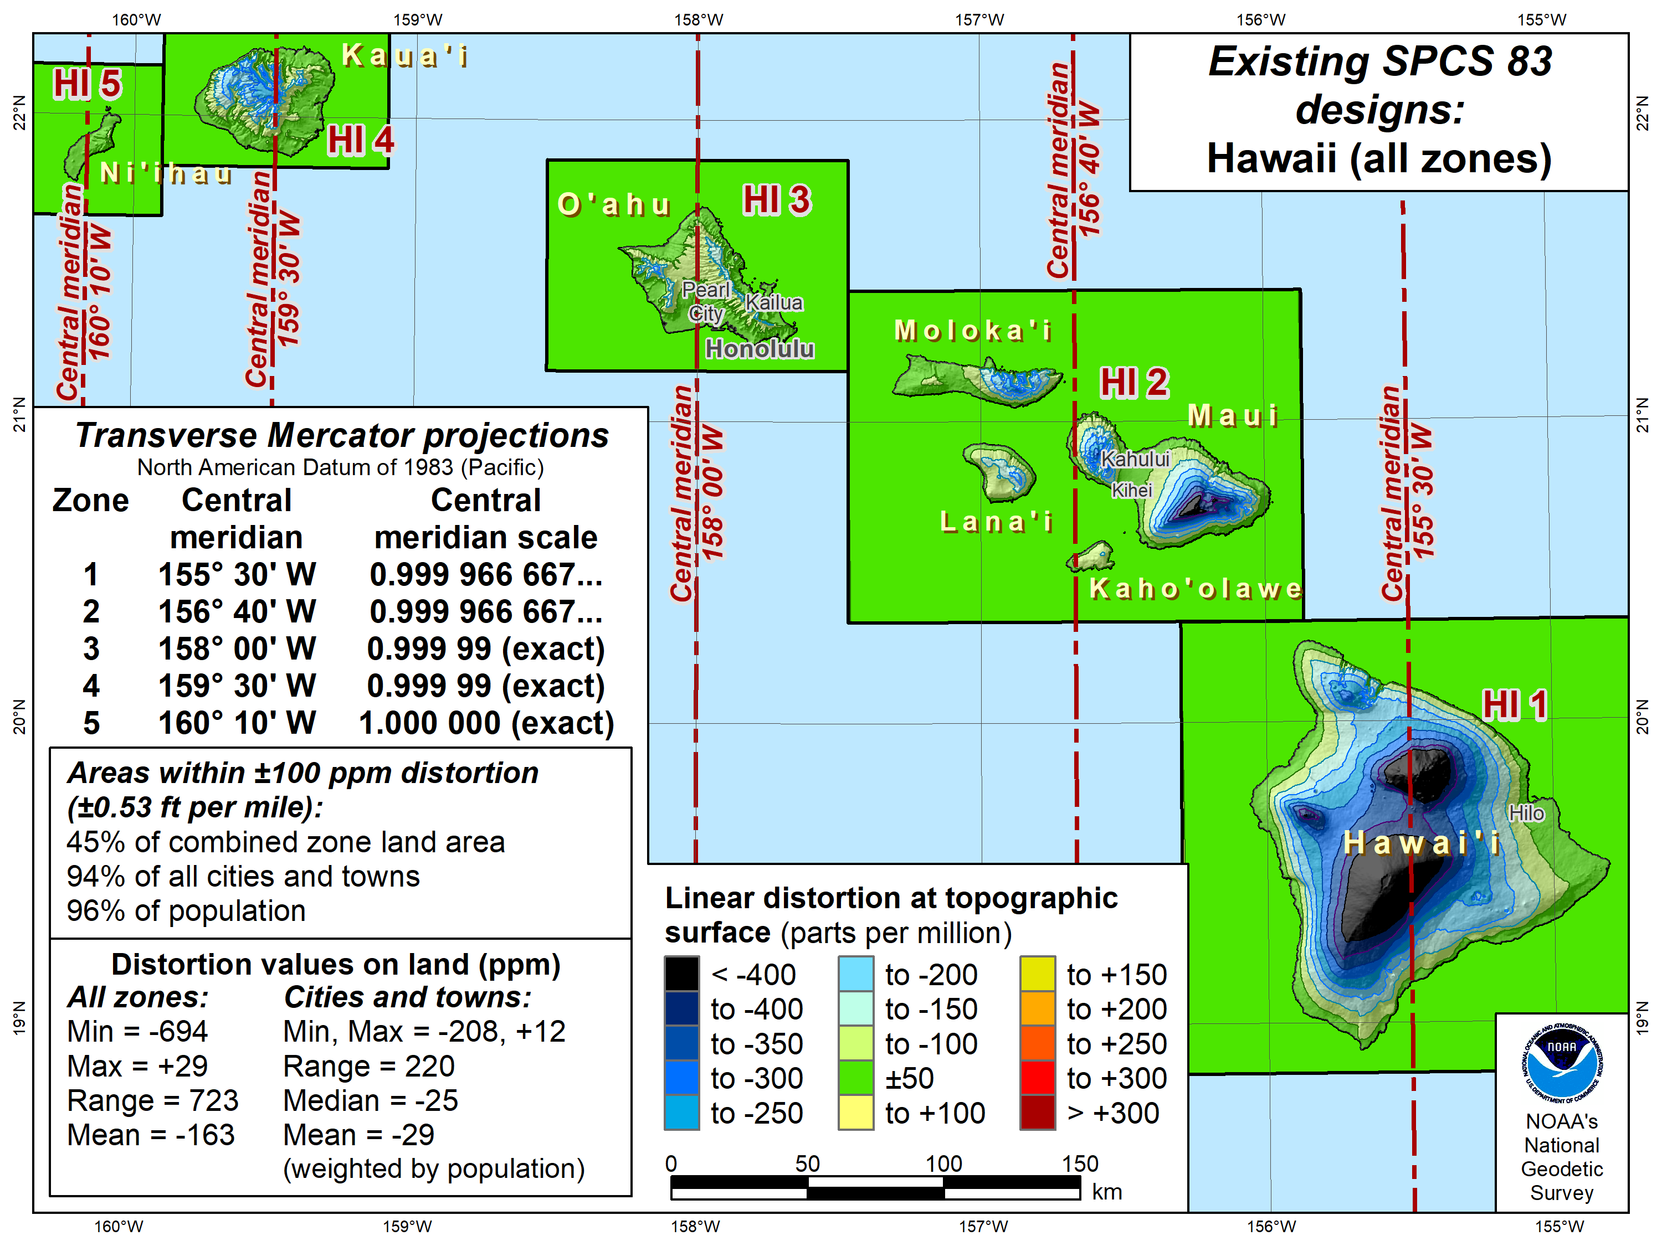
Map Projection Distortion
Refers to distortions that occur when a three-dimensional surface is represented on a two- dimensional map.
Notes:
- from 3d to 2d, distortion occurs – from elevation and curvature
- solution: scale map so it more accurately shows the surface – objective
- plot: utm and spcs – smaller area

Slide 5
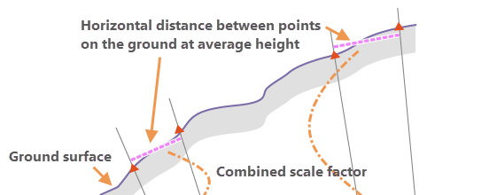


Methods
$$E_{F}=\frac{R_{m}}{h+Rm}$$
Manual:
Elevation Factor: The elevation factor converts distances between the geodetic distances on the lunar surface and the horizontal ground distances.
Grid Scale Factor: ratio to account for the distortion introduced by map projections
Combined Scale Factor: Product of the elevation and grid scale, used to correct combined linear distortion
Dual Annealing Algorithms: Global optimization algorithm which starts with an initial solution and iteratively looks for a better solution based on specific parameters.
- Minimized the residual to be as close to true scale (1.0)
$${C_{F}=E}_{F}∗k$$

Slide 6
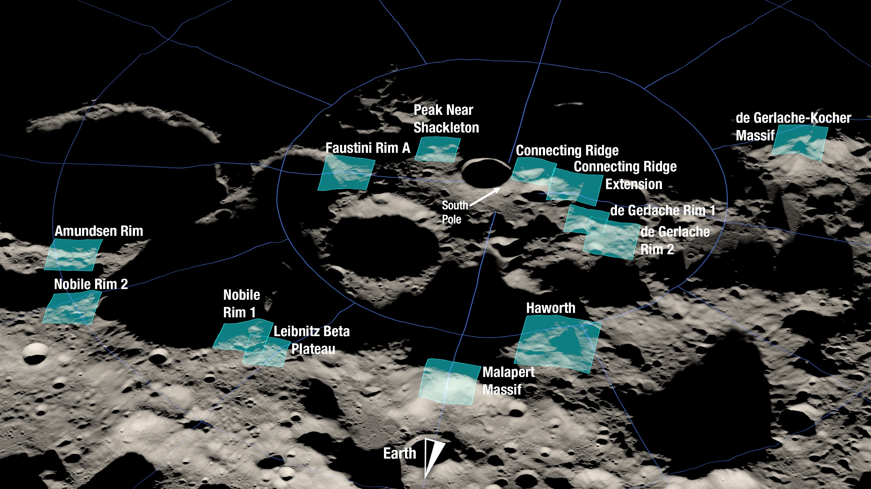
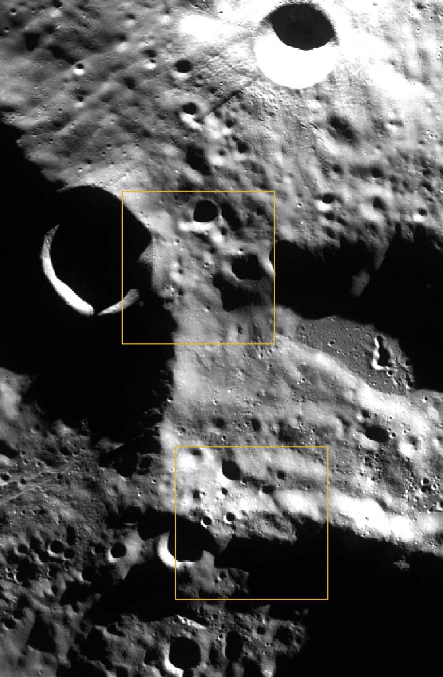
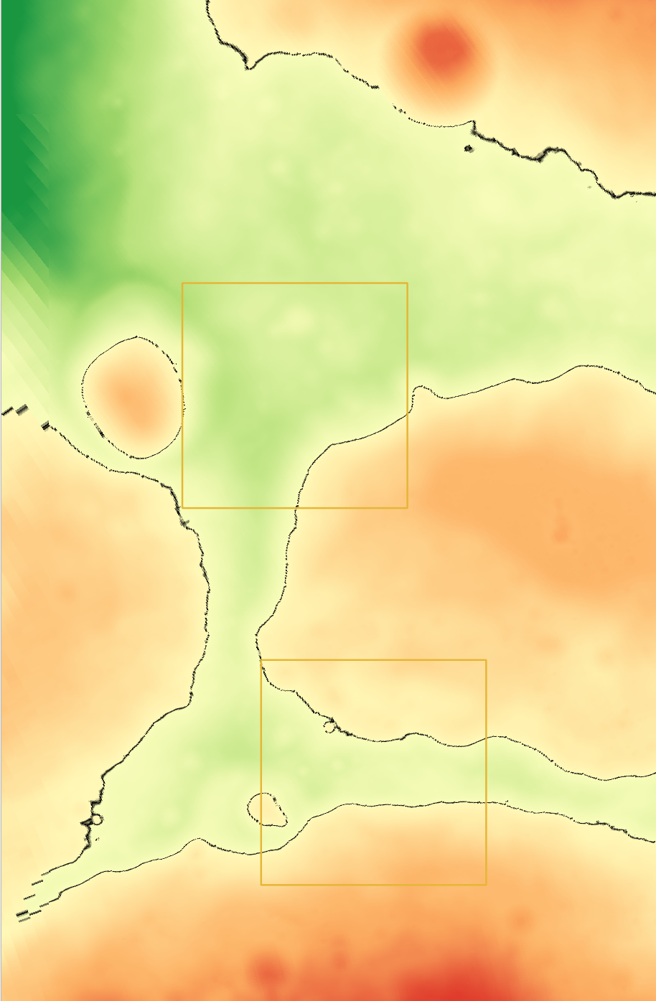

Slide 7
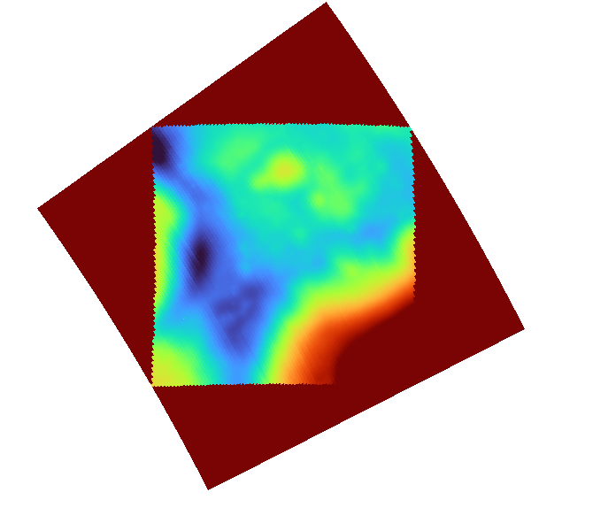
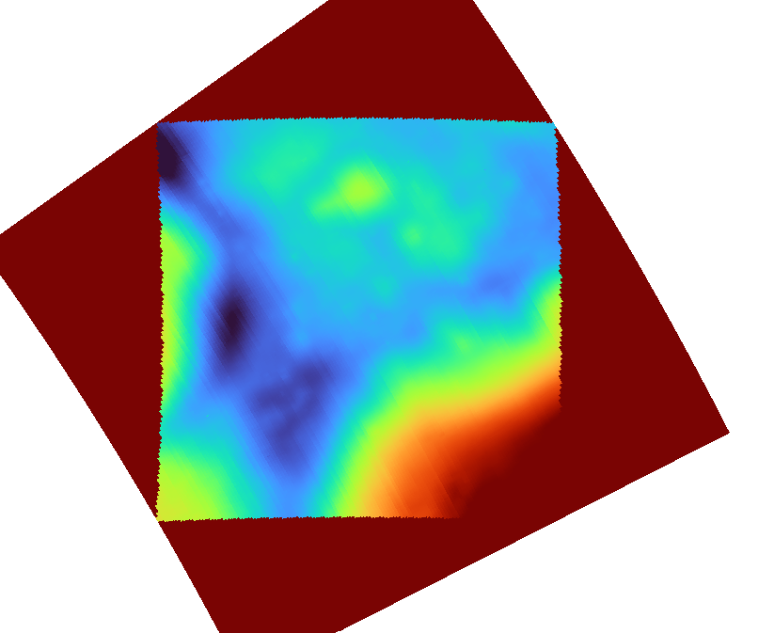
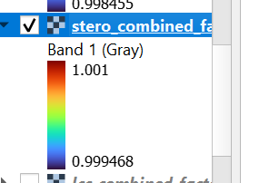
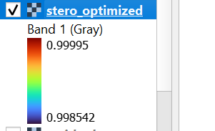
Stereographic
Manual
Optimized
Projected Point: 60.998, -84.999
Projected Point: 58.5, -83.9

Slide 8
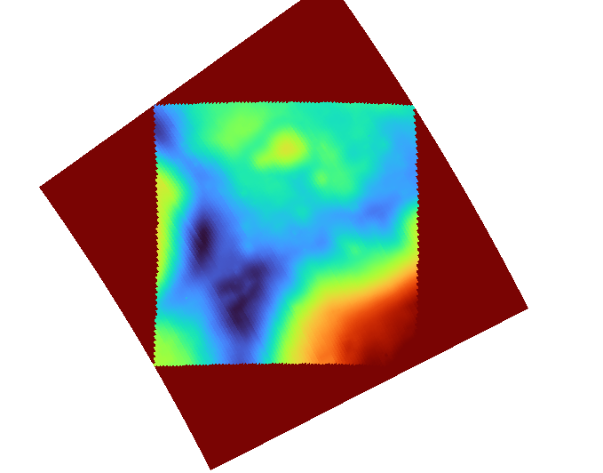
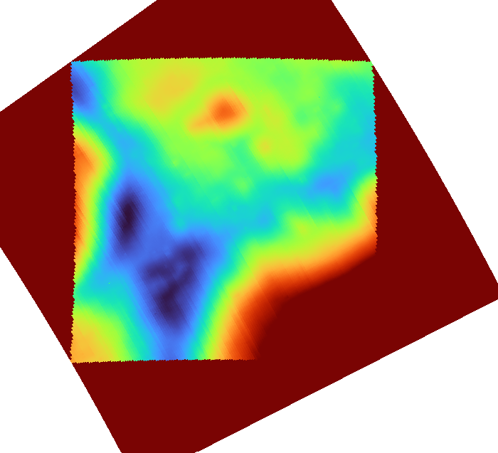
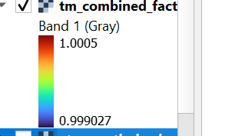
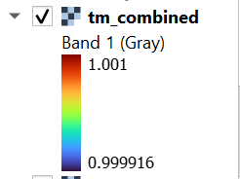
Transverse Mercator
Manual
Optimized
Projected Axis: 59.0
Optimized Axis: 60.99939

Slide 9
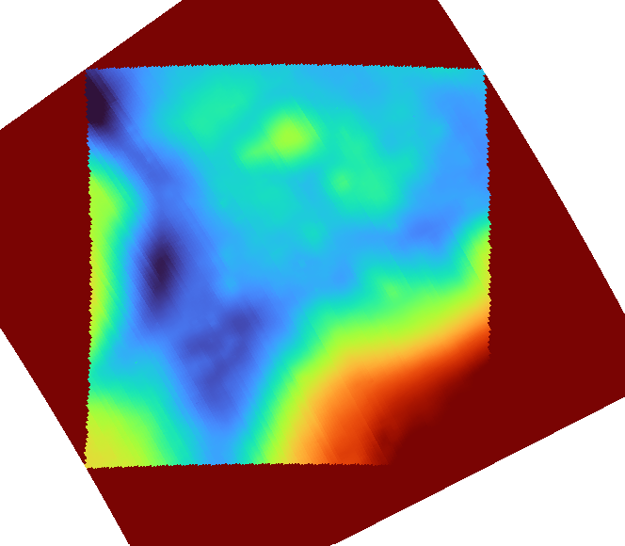
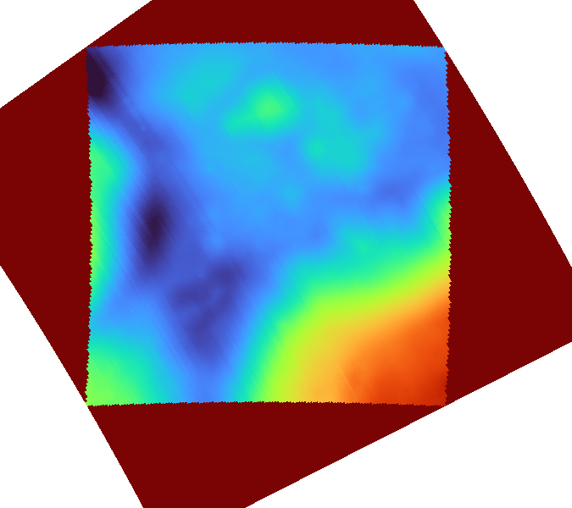
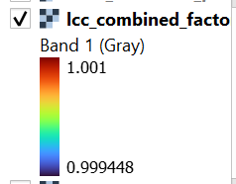
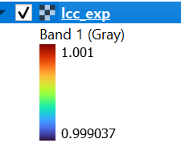
Lambert Conic Conformal
Manual
Optimized
Projected Axis:-84.37
Projected Axis: 84.430766

Slide 10
Stereographic (Projection Point) | K | Statistics | Transverse Mercator (Projection Axis) | K | Statistics | Lambert Conic Conformal | K | Statistics
58.5, -83.9 | 1.0004123 | Mean: 1.0004123 STD: 6.8556e-06 Min: 1.0004017 Max: 1.00043675 Range: 3.506e-05 | 59.0 | 1.005885 | Mean: 1.005885 STD: 0.000476787 Min: 1.0049729 Max: 1.00683422 Range: 0.0018612 | 58.14, -83.92 | 1.000413 | Mean: 1.000413 STD: 1.37372e-05 Min: 1.0004004 Max: 1.0004515 Range: 5.10e-05
56.5, -84.9 | 1.0004833 | Mean: 1.0004833 STD: 3.91223e-05 Min: 1.00042086 Max: 1.0005827 Range: 0.000162 | 60.0 | 1.002698 | Mean: 1.002806 STD: 0.00031594 Min: 1.00210962 Max: 1.00364910 Range: 0.001539 | -59.12, -84.37 | 1.000398 | Mean: 1.000398 STD: 1.2045e-05 Min: 1.00038642 Max: 1.00043157 Range: 4.515e-05
60.2, -83.95 | 1.000414 | Mean: 1.000414 STD: 8.92136e-06 Min: 1.0004017 Max: 1.0004467 Range: 4.502e-05 | 55.0 | 1.0020186 | Mean: 1.0020186 STD: 0.00025896 Min: 1.001470972 Max: 1.00270732 Range: 0.0012363 | -58.68, -84.08 | 1.000407 | Mean: 1.000407 STD: 9.91399e-06 Min: 1.0003972 Max: 1.0004347 Range: 3.749e-05
56.01, -84.94 | 1.000491 | Mean: 1.000491 STD: 4.10725e-05 Min: 1.00042403 Max: 1.00059614 Range: 0.0001721 | 57.0 | 1.00205 | Mean: 1.00205 STD: 0.0002614 Min: 1.0014959 Max: 1.0027459 Range: 0.001250 | 59.19, -83.89 | 1.000414 | Mean: 1.000414 STD: 1.4666e-05 Min: 1.00040080 Max: 1.00045466 Range: 5.386e-05
60.998, -84.999 | 0.999418 | Mean: 0.9995142 STD:4.28854e-05 Min:0.99944515 Max:0.99962001 Range: 0.0001748 | 60.99939 | 0.99513 | Mean: 0.9999598 STD:0.00013523 Min:0.99971961 Max: 1.00030404 Range: 0.0005844 | 56, -84.430766 | 0.9 | Mean: 2.1272119 STD: 0.043288656 Min: 2.05523260 Max: 2.20467602 Range: 0.1494434

Slide 11
Future Work
Explore feasibility on other map projections
Prove Minimization
  Data visualization
  Research & Optimization

